Slide 1
Integrating public mental health literacy (MHL) Case example: immigrant women

Slide 2
Background
Immigrant women face discrimination and subordinate position in various cultures (Delara 2016)
high risk of trauma-related mental health problems (Ekblad 2020)
Mental health literacy refers to recognition, attitudes and knowledge on mental health issues.
Poor awareness and knowledge and strong attitudes towards mental health issues are widely globally recognized
Cultural context matters
perceptions of the concept of mental health varies between cultures
Mental health promotion is crucial for integration of immigrant women in the (new) community
Actions to promote public mental health literacy related topics still limitedin communities (Jorm 2018)

Slide 3
MENTAL HEALTH LITERACY (MHL)
Health literacy (European Mental Health Consortium 2012)
Mental Health Literacy (Jorm et al. 1997)
knowledge, motivation and competences to access, understand, appraise and apply health information
make health related judgements and take decisions maintain or improve quality of life
WHO 2013. Health literacy. the solid facts.
“knowledge and beliefs about mental disorders which aid their recognition, management or prevention.
Can been seen a set of actions that promotes mental health, and reduces stigma and impact of mental health disorders (Jorm 2019)

Slide 4
Source: O'Connor, M., Casey, L. & Clough, B. 2014, "Measuring mental health literacy--a review of scale-based measures", Journal of mental health (Abingdon, England), vol. 23, no. 4, pp. 197-204.
Notes:
MHLS, experience in the recent study

Slide 5
HL - strong predictor of prosperity
European study showed significant determinants for poor HL as low socio-economical status and lower education
“ worse health and thus higher demands for health services seems to be accompanied by lower levels of health literacy” (Sørensen et al. 2019)
i.e overeating, alcohol consumption, and smoking to cope as coping menchanisms (delara 2015)
WHO states that HL predicts economic prosperity
Literate individuals participate and are more successful
Worse socioeconomic status may increase social limitation of immigrant women (Delara 2016)
Sørensen et al. 2019.Health literacy in Europe: comparative results of the European health literacy survey (HLS-EU)

Slide 6
MHL among immigrant women
Poor MHL promotes immigrants’ negative attitudes and misinformation on mental health service and adherence to care (Delara 2016)
Fears and feel of having punished if seeking help for mental health (i.e immigration application)
cultural acceptance and cultural differences between immigrant women and local system
migrants vulnerable to stigmatization and xenophobia
Trauma survivors* (Ekblad Kantor 2017)
> stigma, shame and rejection, low MHL (i.e lack of knowledge and treatment-related doubts) fear of negative social consequences, limited resources, time, and expenses
Female immigrants’ social determinants of mental health. (Delara 2016)

Slide 7
HOW to Improve MHL 3/3
a holistic approach is crucial to addressing mental health determinants at all individual and social levels
Promotion on
Research (bridging the gap)
education (for who?)
Practice (How to support client? PHC workers in key role?)
policy
Integrating IW into society (Park & Kang 2018, Delara 2016)
Park & Kang (2018) states the language proficiency and education level to have the most significant impact on health literacy among immigrants
Notes:
mHealth applications usually
includes interventions focused on health behavior change, diagnosis, data collection and health records, health
worker training, human resource management, supply chain management, and financial transaction

Slide 8
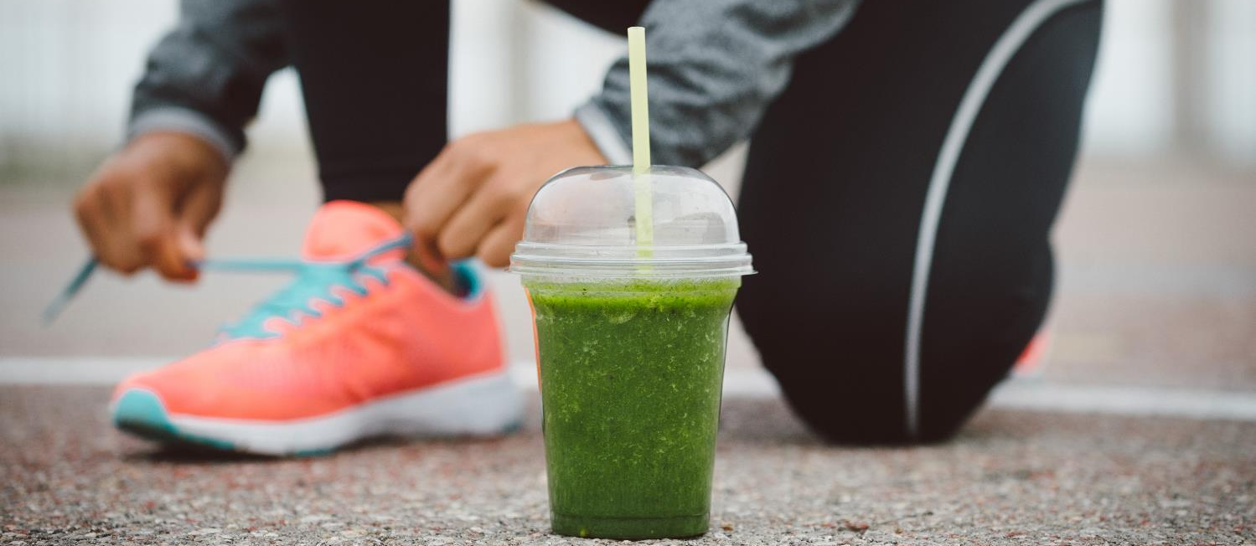
Good mental health infrastructure in smart society
Specified MHL interventions would pay attention to human rights, women’s health, war-affected parents, and mothers with low or no education (Ekblad 202)

Slide 9
Cultural context relates to knowledge and attitudes towars mental health
Building tailor made interventions in relation to cultural context
study (Ekbland 2020) showed that women felt empowered by receiving facts from police, social assistant officer, and health care workers
> healthier lifestyle for the whole family including the children, increased trust towards authorities.

Slide 10
mHEALTH for MHL promotion?
Mass media plays a key role as the most people seek out supplementary information from several mass-media sources
(WHO 2013)
mHealth might release the burden
psychoeducation and self-screenings for PTSD symptoms and suggest self-help interventions
contacting specialized mental health services
(Delara 2016)
Studies have shown that personalized education has more effect on chronic disease than multimedia interventions with no personalized contact. (WHO 2013)

Slide 11
Social media and mobile health transform health care are the great strategy for health care originations to improve health literacy
Threats may apply as social media pose higher risks than i.e print mendia ->needs to be monitored and moderated!

Slide 12
Conclusions
Support social determinants of mental health as (Delara 2016):
social connectedness!
freedom from discrimination and violence!
economic participation!
And interventions to promote MHL; regocnition, knowledge and attitudes towards mental health

Slide 13
Reflective questions for the groups
What kind of benefits do you see on understanding mental health literacy in your clinical work?
What are the main strengths and challenges when supporting patients?

Slide 14
Some related literature
WHO 2013. Health Literacy. The Solid Facts. edit: Kickbuscg I, Pelikan J, Apfel F & Tsouros A..
Furnham, A., & Swami, V. (2018). Mental health literacy: A review of what it is and why it matters. International Perspectives in Psychology: Research, Practice, Consultation, 7(4), 240-257.
Delara M, "Social Determinants of Immigrant Women’s Mental Health", Advances in Public Health, vol. 2016, Article ID 9730162, 11 pages, 2016. https://doi.org/10.1155/2016/9730162
Jorm, A. F. (2000). Mental health literacy. Public knowledge and beliefs about mental disorders. The British Journal of Psychiatry: The Journal of Mental Science, 177, 396–401.
Jorm, A. F., Korten, A. E., Jacomb, P. A., Christensen, H., Rodgers, B., & Pollitt, P. (1997). “Mental health literacy”: A survey of the public’s ability to recognise mental disorders and their beliefs about the effectiveness of treatment. The Medical Journal of Australia, 166(4), 182–186.
Kantor, V., Knefel, M., & Lueger-Schuster, B. (2017). Perceived barriers and facilitators of mental health service utilization in adult trauma survivors: A systematic review. Clinical psychology review, 52, 52–68. https://doi.org/10.1016/j.cpr.2016.12.001

Slide 15
Kutcher, S., Wei, Y., Gilberds, H., Ubuguyu, O., Njau, T., Brown, A., … Perkins, K. (2016). A school mental health literacy curriculum resource training approach: effects on Tanzanian teachers' mental health knowledge, stigma and help-seeking efficacy. International journal of mental health systems, 10, 50. doi:10.1186/s13033-016-0082-6
Kutcher S, Perkins K, Gilberds H, Udedi M, Ubuguyu O, Njau T, Chapota R and Hashish M (2019) Creating Evidence-Based Youth Mental Health Policy in Sub-Saharan Africa: A Description of the Integrated Approach to Addressing the Issue of Youth Depression in Malawi and Tanzania. Front. Psychiatry 10:542. doi: 10.3389/fpsyt.2019.00542
SY Park, H Lee, M Kang, Factors affecting health literacy among immigrants - systematic review, European Journal of Public Health, Volume 28, Issue suppl_4, November 2018, cky214.283, https://doi.org/10.1093/eurpub/cky214.283
Sørensen, K., Pelikan, J., Röthlin, F., Ganahl, K., Slonska, Z., Doyle, G., . . . HLS-EU Consortium. (2015). Health literacy in Europe: Comparative results of the European health literacy survey (HLS-EU). European Journal of Public Health, 25(6), 1053–1058. Retrieved from https://doi.org/10.1093/eurpub/ckv043

Slide 16
Kiitos!
Thank you! Grazie! Tack! Shukran! Merci! Danke! Dank U! Paldies! Takk! Gracias! Efharisto! спасибо! Hvala! Dziękuję! Obrigado! Aitäh! Tak! Köszönöm! Sağol! хвала! Ačiū! Děkuji! Mulțumesc!谢谢! благодаря! Cảm ơn bạn! 고맙습니다!

